Slide 1
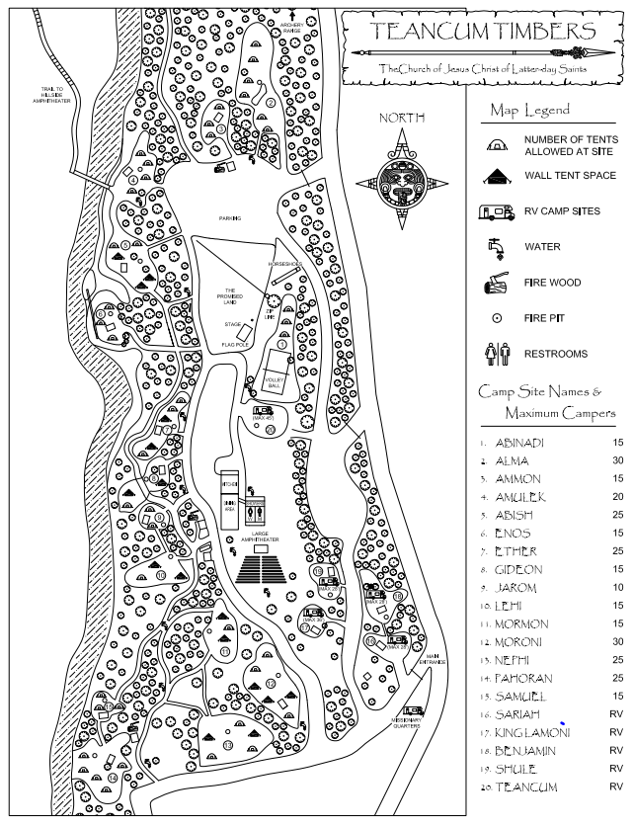

Slide 2
2
3
4
5
6
7
#2 BC2
#3 CON
#4/5 P11
#7/8 VP
#9/10 CB
#12 BC1
#13 P10
#14/15 P1
#17/18/19 Stake
8
9
10
11
17/18/19
12
15
13
14

